Slide 1


Compressed EWK study(ISRC1N2)
Department of Physics, Shandong University
Chengxin Liao
liaocx@ihep.ac.cn
Wed, Jan 22, 2024

Slide 2
Outline
1. Hyperparameters optimization
2. Performance of Model
Chengxin Liao
IHEP SUSY Meeting

Slide 3
Task-list
Machine learning for HH channel
check more Variable and select significance var for ML(DONE)
BDTG hyperparameters optimization/ Setup a Grid Search framework (DONE)
Preliminary study on multibody quantum mechanics (In Progress) QFT Lecture (Peskin part I)
BSc thesis: https://www.overleaf.com/project/674e7119837a2580151a0868
CS61A (python): https://cs61a.vercel.app/index.html
1
Chengxin Liao
IHEP SUSY Meeting

Slide 4
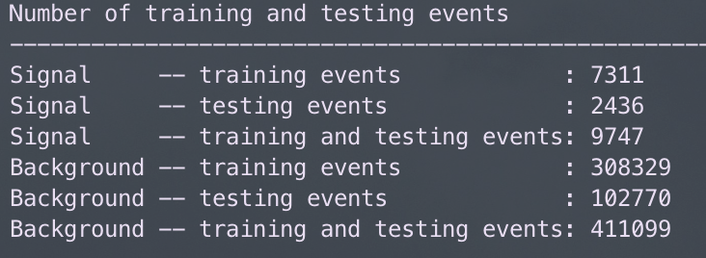
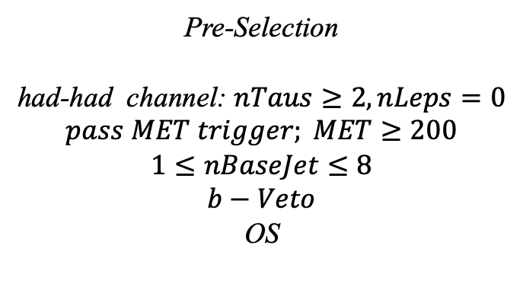
Hyperparameters optimization
Input(HH-Channel):
Sample:
Sig: ISRC1N2(mass_C1 = 100GeV, mass_N2 = 70GeV)->12180 entries
Bkg: 513850 entries
All input data(C1N2_100_70 and Bkg) already passed pre-selection
Pre-Selection
had-had channel: $nTaus≥2, nLeps=0$
$$pass MET trigger; MET≥200$$
$$1≤nBaseJet≤8$$
$$b−Veto$$
OS
Strategy:
method: BDTG Separate sig(bkg) into five folders, one for test, the other three for train, and last one for validation set,then traverse all possibilities.
2
Chengxin Liao
IHEP SUSY Meeting

Slide 5
Hyperparameters optimization
Variables:
Obj kinematics pt_lep pt_tau mt_tau e_lep(energy of tau2)
Angular correlations dPhit1x dRt1x dRtt dPhitt
Event kinematics
Mll(Invariant Mass of tau1 and tau2) METsig MT2_50 Mwh(Invariant Mass of tau1 and MET) Mwl(Invariant Mass of tau2 and MET) MCT(Transverse Mass Squared) Proj_j(Projection of pt jet on zeta) Proj_tt(Projection of tau1+tau2 on zeta)
mt_quad_sum mt_sum frac_MET_tau1 frac_MET_tau2
frac_MET_sqrtHT_40
frac_jet_tau1
frac_jet_tau2 frac_jet_tt
Note:
zeta is bisector direction of tau1 and tau2[PhyUtils::bisector(tau1, tau2)]
3
Chengxin Liao
IHEP SUSY Meeting

Slide 6
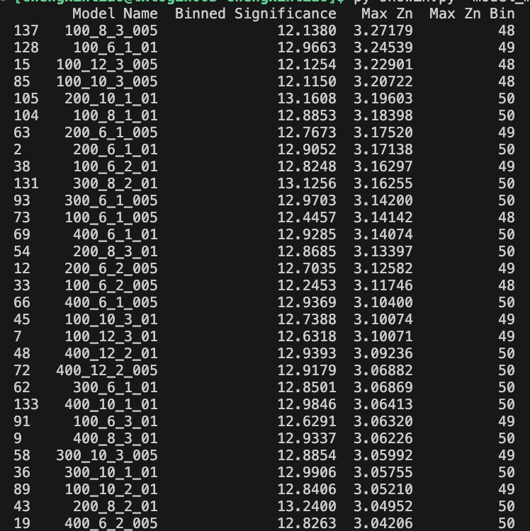
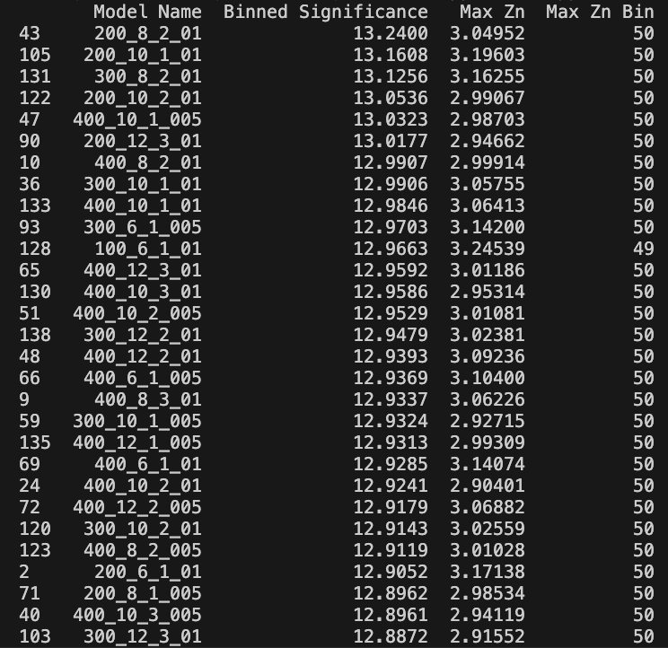
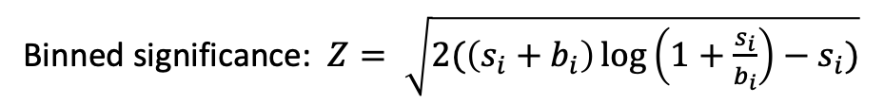
Hyperparameters optimization
Grid Search:
Binned significance: $Z= \sqrt{2(\left(s_{i}+b_{i}\right)\log\left(1+\frac{s_{i}}{b_{i}}\right)−s_{i})}$
Ntrees: 200, 300, 400
Max Depth: 6, 8, 10, 12 MinNodeSize: 1%, 2%, 3% Learning Rate: 0.01, 0.05, 0.1
Show top Zn
Show top binned significance
300_8_2_01 300_6_1_005
4
Chengxin Liao
IHEP SUSY Meeting

Slide 7
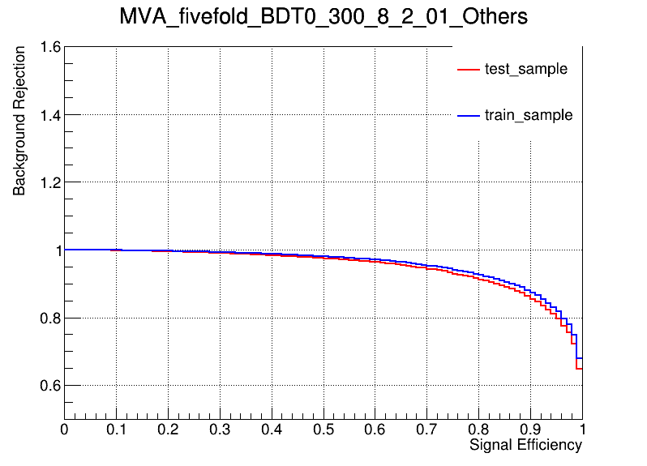
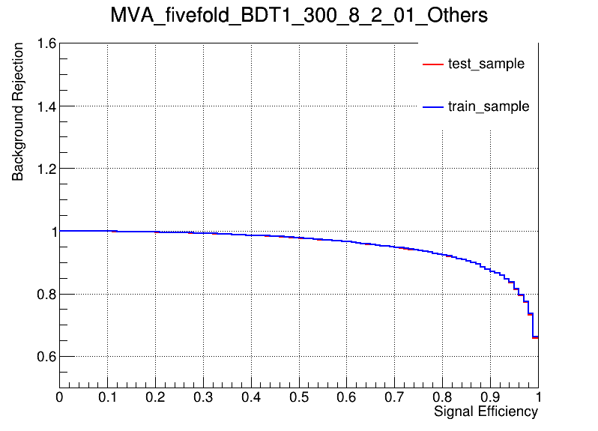
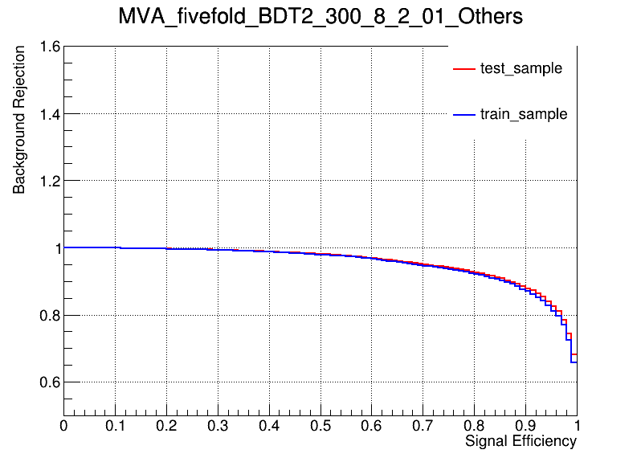
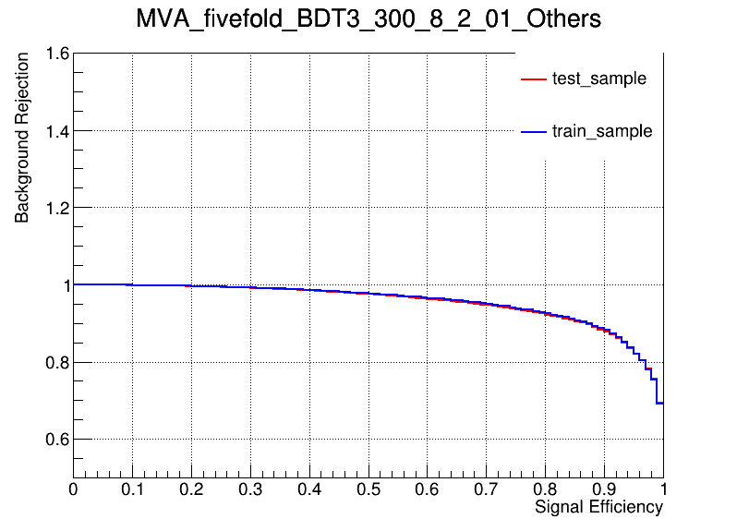
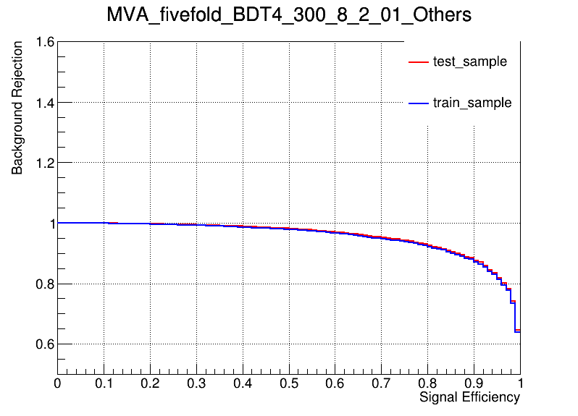
Performance of Model
Model
hyper parameter: NTrees=300, learning rate=0.1, max depth=8, MinNodeSize=2%(default)
ROC Curve
AUC: 0.949 sig eff from test(train) @B = 0.01 0.308(0.363) @B = 0.10 0.834(0.866) @B = 0.30 0.988(0.992)
AUC: 0.954 sig eff from test(train) @B = 0.01 0.345(0.350) @B = 0.10 0.863(0.863) @B = 0.30 0.989(0.990)
AUC: 0.957 sig eff from test(train) @B = 0.01 0.366(0.350) @B = 0.10 0.871(0.858) @B = 0.30 0.992(0.989)
AUC: 0.954 sig eff from test(train) @B = 0.01 0.321(0.343) @B = 0.10 0.866(0.873) @B = 0.30 0.994(0.994)
AUC: 0.956 sig eff from test(train) @B = 0.01 0.382(0.341) @B = 0.10 0.864(0.855) @B = 0.30 0.989(0.989)
Conlusion: seems no overtraining in 300_8_2_01
5
Chengxin Liao
IHEP SUSY Meeting

Slide 8

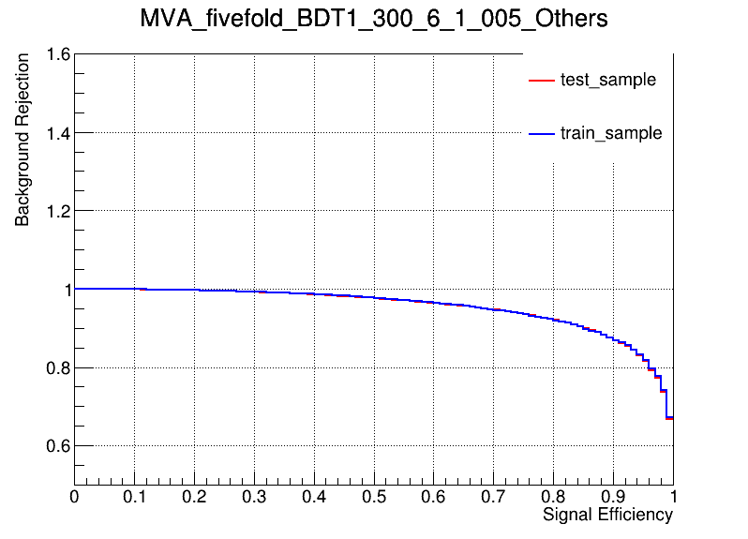
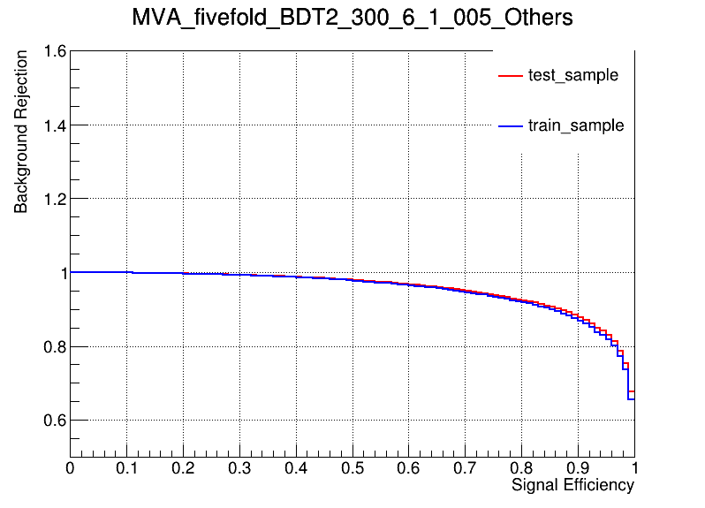
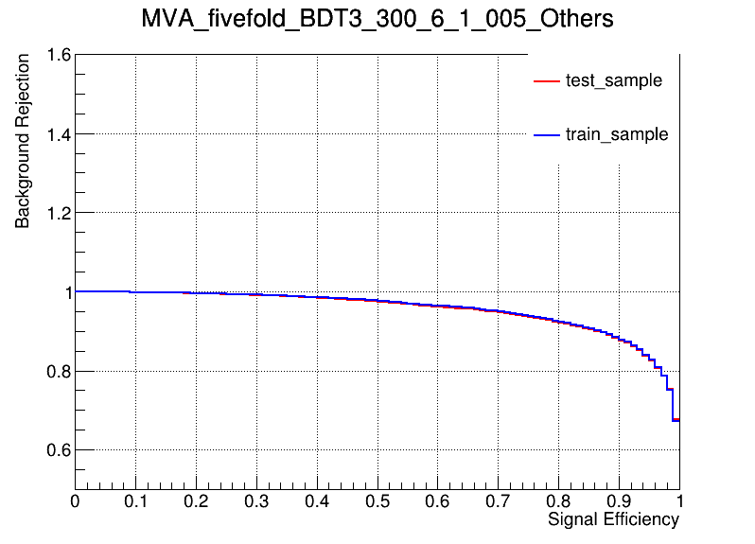
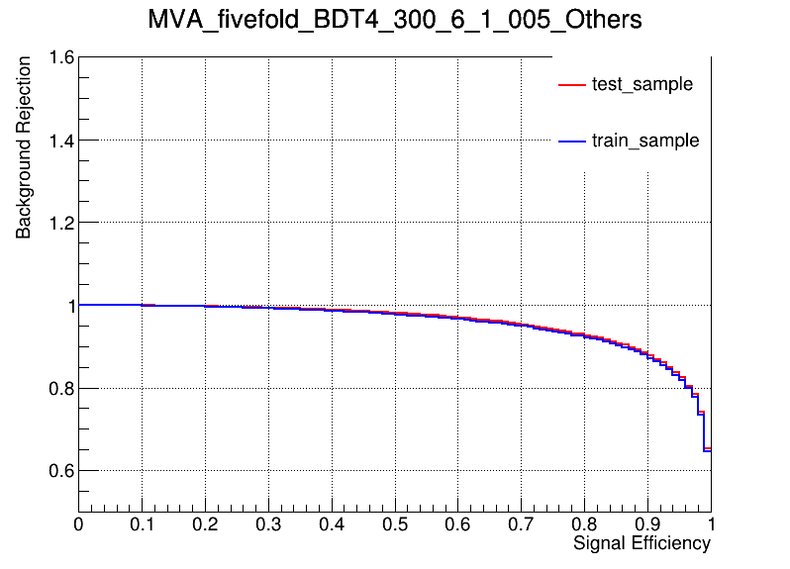
Performance of Model
Model
hyper parameter: NTrees=300, learning rate=0.05, max depth=6, MinNodeSize=1%(default)
ROC Curve
AUC: 0.949 sig eff from test(train) @B = 0.01 0.305(0.349) @B = 0.10 0.834(0.861) @B = 0.30 0.988(0.992)
AUC: 0.953 sig eff from test(train) @B = 0.01 0.341(0.343) @B = 0.10 0.852(0.851) @B = 0.30 0.990(0.991)
AUC: 0.956 sig eff from test(train) @B = 0.01 0.358(0.349) @B = 0.10 0.867(0.855) @B = 0.30 0.992(0.990)
AUC: 0.954 sig eff from test(train) @B = 0.01 0.321(0.339) @B = 0.10 0.865(0.871) @B = 0.30 0.992(0.992)
AUC: 0.957 sig eff from test(train) @B = 0.01 0.376(0.337) @B = 0.10 0.870(0.860) @B = 0.30 0.990(0.989)
Conlusion: seems no overtraining in 300_6_1_005
6
Chengxin Liao
IHEP SUSY Meeting

Slide 9
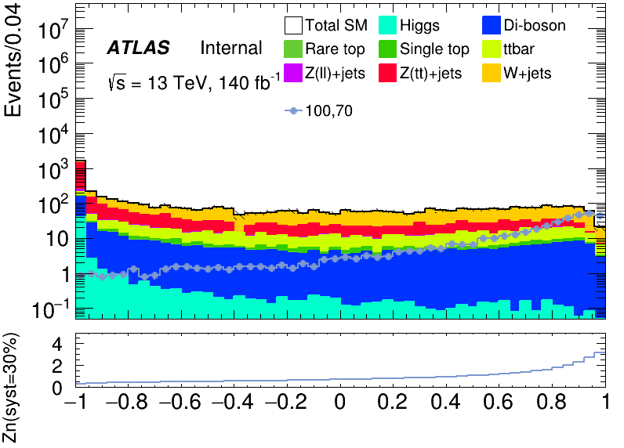
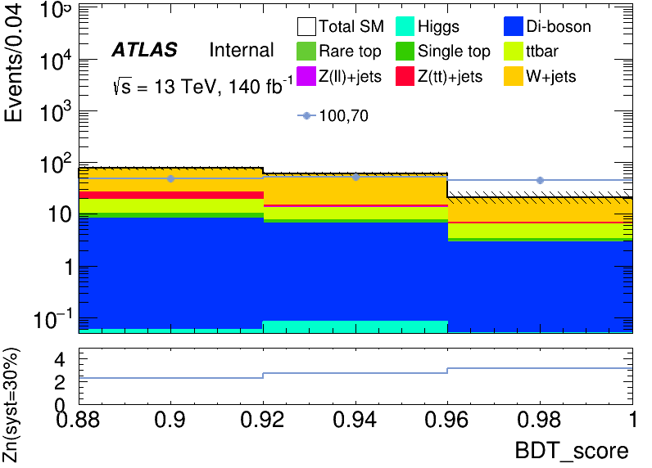
Performance of Model
BDT distribution
300_8_2_01
Apply BDT score cut > 0.88
bin | max Zn | C1N2ISR (100,70) | bkg | Higgs | OtherTop | SingleTop | TopPair | VV | Wjets | Zlljets | Zttjets
48 | 2.31643 | 47.944+- 1.326 | 76.74+- 11.617(15%) | 0.057+- 0.017 | 0.069+- 0.035 | 1.816+- 0.518 | 8.389+- 1.142 | 8.144+- 0.547 | 50.716+- 7.999 | 0.180+-0.055 | 7.371+- 0.929
49 | 2.75157 | 52.649+- 1.922 | 59.26+- 8.262(14%) | 0.083+- 0.040 | 0.028+- 0.045 | 0.883+- 0.591 | 5.847+- 1.486 | 6.432+- 0.646 | 44.437+- 9.834 | 0.116+- 0.084 | 1.430+- 1.767
50 | 3.16255 | 44.891+- 2.313 | 21.25+- 5.661(26%) | 0.008+- 0.040 | 0.057+- 0.052 | 0.388+- 0.632 | 2.996+- 1.632 | 2.826+- 0.682 | 14.443+- 11.326 | 0.132+- 0.139 | 0.402+- 1.770
7
Chengxin Liao
IHEP SUSY Meeting

Slide 10
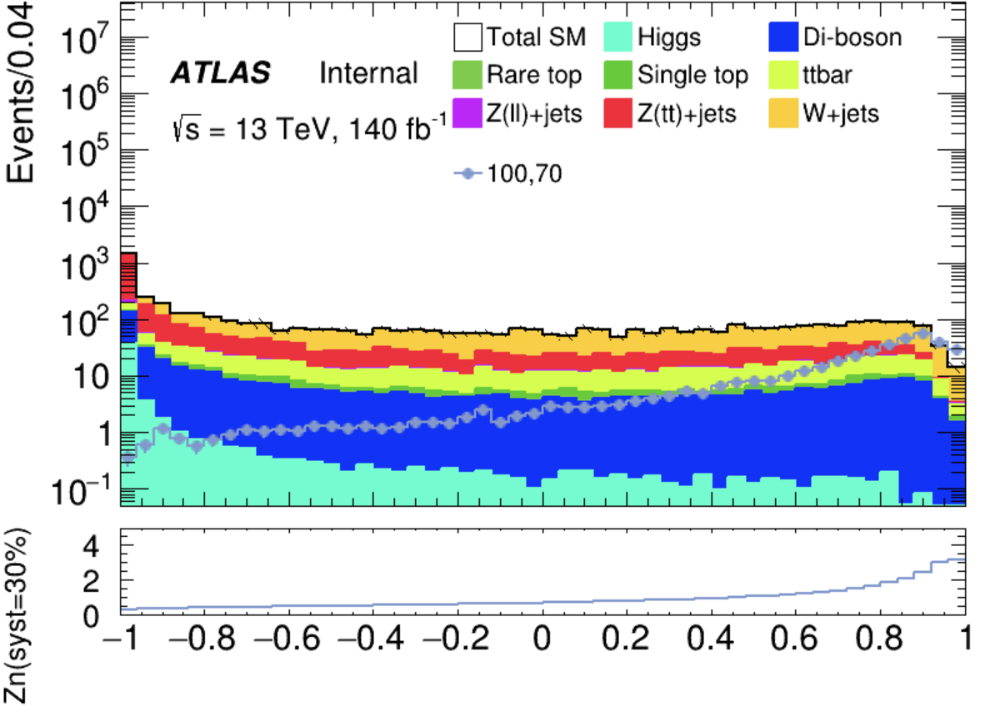
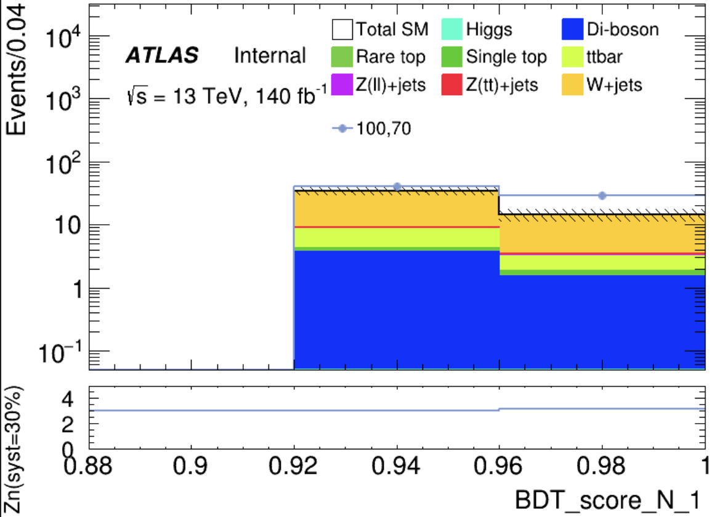
Performance of Model
BDT distribution
Apply BDT score cut > 0.90
300_6_1_005
bin | max Zn | C1N2ISR (100,70) | bkg | Higgs | OtherTop | SingleTop | TopPair | VV | Wjets | Zlljets | Zttjets
49 | 2.9951 | 40.056+-1.219 | 34.064+-5.980 (17%) | 0.035+-0.017 | 0.014+-0.018 | 0.406+-0.228 | 4.206+-0.797 | 3.740+-0.251 | 24.850+-5.017 | 0.075+-0.054 | 0.740+-0.135
50 | 3.142 | 29.295+-1.601 | 14.341+- 3.133(21%) | 0.001+-0.017 | 0.051+-0.027 | 0.306+-0.314 | 1.284+-0.919 | 1.500+-0.297 | 10.859+-5.890 | 0.128+-0.123 | 0.213+-0.155
8
Chengxin Liao
IHEP SUSY Meeting

Slide 11
TODO
1. Optimize ML model and try other method
2. Completing the theoretical section of the my thesis
9
Chengxin Liao
IHEP SUSY Meeting

